Slide 1



HW 2
2024 Computer Organization : Performance Modeling for the μRISC-V Processor
Chia-Heng Tu
Dept. of Computer Science and Information Engineering
National Cheng Kung University

Slide 2

Outline
Overview
Structure
Exercise
Judge
Submission
Deadline
How to Mail TAs

Slide 3
Overview
The performance model used in this assignment uses performance metrics to summarize the delivered performance of a RISC-V instruction executed on the target RISC-V processor, including the effect of the CPU pipeline and the memory subsystem.
Given the above modeling concept, you will need to collect the performance data of your program to derive the CPU execution time. Specifically, you need to record the instruction counts of different types of RISC-V instructions.
The instructions are categorized into seven types and their instruction counts should be recorded (accumulated) in the seven counters: add_cnt, sub_cnt, mul_cnt, div_cnt, lw_cnt, sw_cnt, and others_cnt, respectively.
The CPIs for the seven types of instructions, add_CPI, sub_CPI, mul_CPI, div_CPI, lw_CPI, sw_CPI, and others_CPI as constants.

Slide 4
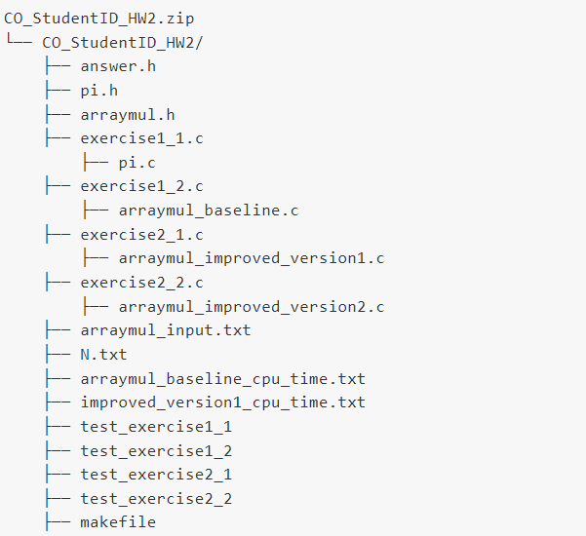
Structure
You will receive the code with the following structure:

Slide 5
Structure – Exercise
File description for Exercise1-1 and 1-2:
Lab2 exercise1-1
exercise1_1.c: main file, starting from this file.
pi.h: definition of exercise1_1.c.
pi.c: implementation answer here.
answer.h: compute performance here.
N.txt: write down your answer in this file.
Lab2 exercise1-2
exercise1_2.c: main file, starting from this file.
arraymul.h: definition of exercise1_2.c, exercise2_1.c, exercise2_2.c.
arraymul_baseline.c: implementation answer here.
answer.h: compute performance here.
arraymul_baseline_cpu_time.txt: cpu time is stored in this file.

Slide 6
Structure – Exercise
File description for Exercise2-1 and 2-2:
Lab2 exercise2-1
exercise2_1.c: main file, starting from this file.
arraymul.h: definition of exercise1_2.c, exercise2_1.c, exercise2_2.c.
arraymul_improved_version1.c: implementation answer here.
answer.h: compute performance here.
improved_version1_cpu_time.txt: cpu time is stored in this file.
Lab2 exercise2-2
exercise2_2.c: main file, starting from this file.
arraymul.h: definition of exercise1_2.c, exercise2_1.c, exercise2_2.c.
arraymul_improved_version2.c : implementation answer here.
answer.h: compute performance here.

Slide 7
Structure – Judge files
You will receive the four judge programs to test your exercises.
Common
makefile: help you compile and run code.
test_execise1_1: testing your execise1_1.
test_execise1_2: testing your execise1_2.
test_execise2_1: testing your execise2_1.
test_execise2_2: testing your execise2_2.

Slide 8
Structure – Modify files
You have to modify five files in this assignment.
You should write your answer in:
answer.h
pi.c
N.txt
arraymul_baseline.c
arraymul_improved_version1.c
arraymul_improved_version2.c
Don’t modify other files. But you can read other files to help you finish your homework.

Slide 9
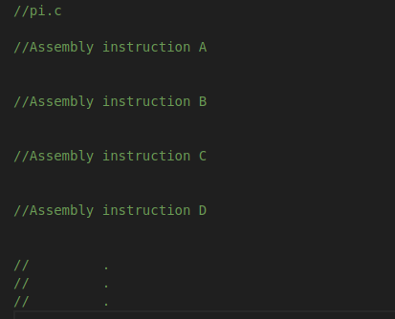
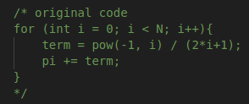

Exercise1-1(40%): Calculating $π$
Step1: Translate C code to Assembly in pi.c
Variables N is defined in the header files(pi.h) and is used to determine the number of iterations, you can only change N(the number of iterations) in pi.h.

Slide 10
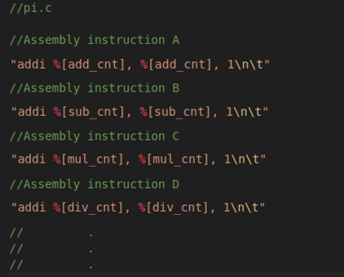
Exercise1-1(40%): Calculating $π$
Step2: Insert the assembly code into pi.c to count the number of instructions, according to the
types of the instructions, and to store the accumulated counts in the respective counters.
The seven counters values which are define in pi.h:
add_cnt (4%)
sub_cnt (4%)
mul_cnt (4%)
div_cnt (4%)
lw_cnt (4%)
sw_cnt (4%)
others_cnt(4%)

Slide 11

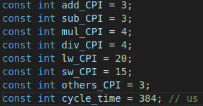
Exercise1-1(40%): Calculating $π$
Step3: Add the related code(formula) in answer.h to set up the value for performance data.
answer.h
pi.h
The total cycle count (pi_cycle_count)(4%)
formula: Clock Cycles = Instruction Count * Cycles per Instruction
The CPU time (pi_cpu_time)(4%)
formula: Instruction Count * CPl * Clock Cycle Time
What is the maximum value of N and the program is still memory bound? Please manually record the answer into N.txt. (4%)
formula: (clock cycles for the instructions other than load/store instructions) / (clock cycles for all the instructions)

Slide 12

Exercise1-2(40%): Array multiplication
Step1: Translate C code to Assembly in arraymul_baseline.c
Step2: Insert the assembly code into arraymul_baseline.c to count the number of instructions, according to the
types of the instructions, and store the accumulated counts in the respective counters
Step3: Add the related code(formula) in answer.h to set up the value for performance data.
Variables arr_size is defined in the header files(arraymul.h) and is used to determine the number of array size, you can only change arr_size(array size) in arraymul.h, log2(arr_size) must be a integer.
The seven counters values(28%)
The total cycle count (arraymul_baseline_cycle_count)(4%)
The CPU time (arraymul_baseline_cpu_time)(4%)
Choose any arr_size but log2(arr_size) must be a integer and answer the question: Is this program a CPU bound or Memory bound program?(4%)

Slide 13
Exercise2-1(50%): Vectorized Code
Some useful vector extension instruction: vsetvli, vle16.v vle32.v, vse16.v, vse32.v, vadd.vv, vmseq.vv…
Read V extension spec(how to use instruction, read example).
riscv-v-spec-1.0.pdf
Introduction to the RISC-V Vector Extension

Slide 14
Exercise2-1(50%): Vectorized Code
Step1: Using the RISC-V V extension to Rewrite Assembly Code in exercise 1-2 and Report the Performance
Statistics, run Spike simulator with custom configurations(vlen=128, elen =16).
The Vector Register Width (vlen)
The Element Width (elen)
vlen = 128 bits
V0
V1
V2
V3
0
1
2
3
4
5
6
7
each element has 16 bits

Slide 15
Exercise2-1(50%): Vectorized Code
Step2: Insert the assembly code into arraymul_improved_version1.c to count the number of instructions,
according to the types of the instructions, and to store the accumulated counts in the respective counters.
Step3: Add the related code(formula) in answer.h to set up the value for performance data.
The seven counters values(28%)
The total cycle count (improved_version1_cycle_count)(4%)
The CPU time (improved_version1_cpu_time)(4%)
Speedup(14%)
If 6 < speedup, you get (14 pt).
If 4 < speedup < 6, you get (9 pt).
If 2 < speedup < 4, you get (5 pt).
If speedup < 2, you get (0 pt).
You have to complete exercise1-2 first!

Slide 16
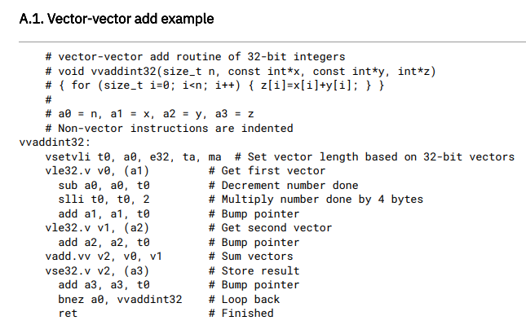
Exercise2-1(50%): Vectorized Code Example

Slide 17
Exercise2-2(10%): Vectorized Code
Step1: Using the RISC-V V extension to Rewrite Assembly Code in exercise 2-1 and Report the Performance
Statistics, run Spike simulator with custom configurations(vlen=256, elen=16) with the same speed
as 2-1.
Step2: Insert the assembly code into arraymul_improved_version2.c to count the number of instructions,
according to the types of the instructions, and to store the accumulated counts in the respective counters.
Step3: Add the related code(formula) in answer.h to set up the value for performance data.
vlen = 256 bits
V0
V1
V2
V3
0
1
2
3
4
5
6
7
8
9
10
11
12
13
14
15
each element has 16 bits
You have to complete exercise2-1 first!
Speedup(10%)

Slide 18




Judge
We use makefile to judge your program. You can use the judge program to get the testing score by typing judge in your terminal.
Test your Exercise1-1 in lab2
Test your Exercise1-2 in lab2
Test your Exercise2-1 in lab2
Test your Exercise2-2 in lab2

Slide 19
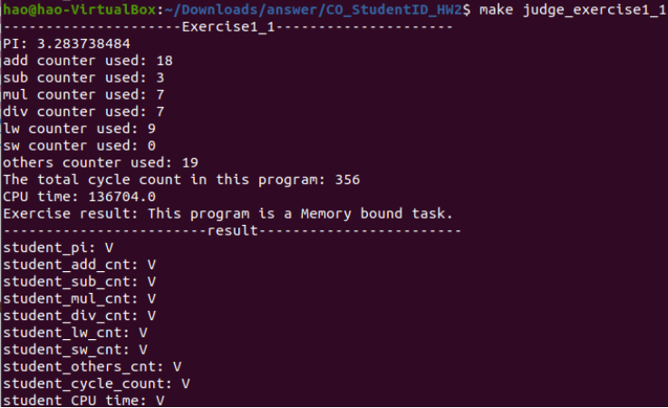
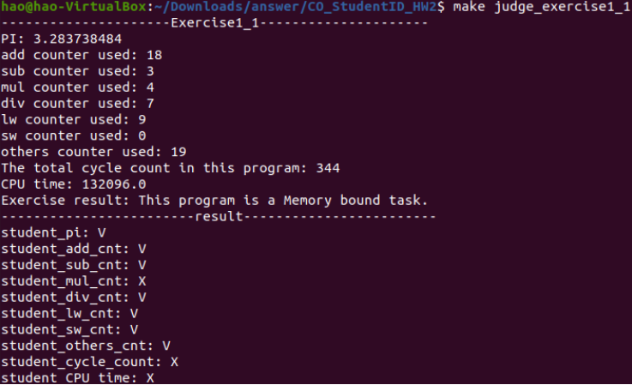
Judge
We use makefile to judge your program. You can use the judge program to get the testing score by typing judge in your terminal.
Pass
Error

Slide 20
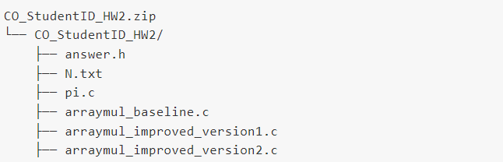
Submission
We assume your developed code is inside the folder: CO_StudentID_HW2. Please follow the instructions below to submit your programming assignment.
Compress your source code into a zip file.
Submit your homework with NCKU Moodle.
The zipped file and its internal directory organization of your developed code should be similar to the example below.
NOTE: Replace all StudentID with your student ID number!!
!!! Incorrect format (either the file structure or file name) will lose 10 points. !!!

Slide 21
Deadline
Postpone
30% off
Scoreless
4/11
Hw2 release
5/8
23:59 Deadline
5/15
23:59

Slide 22
How to Mail TAs
Send mail to asrlab@csie.ncku.edu.tw, not any TA’s mail!!
Email subject starts with “[Comp2024]”
Thoroughly read document before asking questions.

